Slide 1
LGB
OPERATIONS TECHNOLOGY
October 2026
Plant Digitalization Projects
K.Palayam, P.Palayam, Pongalur, Annur
LGB | Operations Technology

Slide 2
PROJECT OVERALL LIST
S.No | Plant | Line | Task | Description | Start Date | End Date
1 | K.Palayam | RAD | BMW Digitalization | PRISM & Operator Buddy Implementation, Machine Interlock | 01.10.2026 | 30.10.2026
2 | K.Palayam | RAD | BMW Digitalization | Data Collection form Machine | 12.10.2026 | 15.10.2026
3 | K.Palayam | BOSCH | Bosch Digitalization | Data Collection form Machine | 09.10.2026 | 10.10.2026
4 | K.Palayam | BMW | BMW Digitalization | Grinding Machine Datalogging | 09.10.2026 | 09.10.2026
5 | K.Palayam | BOSCH | Bosch Digitalization | Data Collection form Machine | 10.10.2026 | 10.10.2026
6 | Annur | CMBF | Furnace Dashboard | Data logging from furnace | 14.10.2026 | 15.10.2026
7 | Annur | Rotary Furnace | Furnace Dashboard | Data logging from furnace | 19.10.2026 | 30.10.2026
8 | PGR | SQF | Furnace Dashboard | Energy Meter Data Collection from Furnace | 05.10.2026 | 27.10.2026
9 | PGR | SQF | Furnace Dashboard | Furnace Charge in and Charge OUT Data Collection | 05.11.2026 | 12.11.2026
10 | PGR | CNC | CNC Digitalization | Data Collection form Machine | 06.10.2026 | 07.10.2026
11 | P.Palayam | SQF | Furnace Dashboard | Data Collection from Furnace | 07.10.2026 | 07.10.2026
12 | P.Palayam | Chain | Press Dashboard | Data Collection from Stamping Press | 01.11.2026 | 01.11.206
13 | P.Palayam | Daimler | Daimler Line Digitalization | Data Collection from Machines and Showing it in PRISM | 05.10.2026 | 05.11.2026
14 | P.Palayam | Daimler | Daimler Line Automation | Data Collection from COBOT PLC using its tags and display it in Prism | 05.10.2026 | 05.11.2026
15 | P.Palayam | Stellantis | Stellantis Line Digitalization | Data need to pushed from SQLite to MongoDB | 12.10.2026 | 13.10.2026
16 | Vaiyampalayam | SQF | Furnace Dashboard | Data Collection from Furnace | 27.10.2026 | 30.10.2026
17 | Nagpur | Sprocket | CNC Digitalization | Data Collection from CNC Machines | 01.10.2026 | 01.12.2026
18 | Nagpur | Sprocket | Press Dashboard | Data Collection from Stamping Press | 01.10.2026 | 01.12.2026
LGB l Operations Technology

Slide 3
01
BMW Digitalization
K.Palayam Plant

Slide 4
BMW Line ( OCT PLAN vs ACTUAL )
BMW Line
S.No | Task Description | Responsibility | Planned |  | Actual |  | Status | % Complete | Remarks
 |  |  | Start Date | End Date | Start Date | End Date
1 | New Machines DataLogging | Plant IT | 05-Sep-26 | 25-Sep-26 | 09-Oct-26 | 17-Oct-26 | InProgress | 50% | 4 machines pending for Ethernet
2 | Operator Buddy Implentation RAD | Gowtham | 01-Aug-26 | 30-Sep-26 | 15-Sep-26 | 17-Oct-26 | InProgress | 80% | Plant side testing in Progress
3 | Grinding Machine Data Collection | MBD | 19-Aug-26 | 22-Sep-26 | 23-Sep-26 | 17-Oct-26 | InProgress | 10% | -
4 | Machine Interlock in B Block | Gowtham | 31-Oct-26 | 31-Nov-26 | - | - | Not Started | - | IOT device needed
5 | Operator Buddy Implentation Klinke | Gowtham | 14-oct-26 | 14-Nov-26 | - | - | Not Started | - | -
6 | Overall machine BMW data collection | Plant Team | 01-Aug-26 | 31-Sep-26 | 07-Sep-26 | 01-Nov-26 | InProgress | 25% | Total 32 machine 17 machines displaying in prism balance (mail has been given to plant side for ethernet)
LGB l Operations Technology

Slide 5
02
Bosch Digitalization
K.Palayam Plant

Slide 6
Bosch Line ( OCT PLAN vs ACTUAL )
Bosch Line
S.No | Task Description | Responsibility | Planned |  | Actual |  | Status | % Complete | Remarks
 |  |  | Start Date | End Date | Start Date | End Date
1 | New Machines Datalogging | Plant IT | 10-Sep-26 | 01-Oct-26 | 01-Oct-26 | 17-Oct-26 | InProgress | 60% | 3 Macines Pending for IP Assignment
2 | Operator Buddy Implentation | Gowtham | 01-Aug-26 | 30-Sep-26 | 15-Sep-26 | 17-Oct-26 | InProgress | 5% | Edge Device need to Purchase (Mail has been given to plant team)
3 | Deburring Machine DataCollection | Plant Production Team | 19-Aug-26 | 22-Sep-26 | 23-Sep-26 | 17-Oct-26 | InProgress | 10% | Vendor Assistance is pending
4 | Overall machine Bosch data collection | Plant Team | 01-Aug-26 | 31-Sep-26 | 07-Oct-26 | 07-Nov-26 | InProgress | 25% | Total 60 machine 15 machines displaying in prism balance no device and ethernet cables (mail has been given to plant side for BOM)
LGB l Operations Technology

Slide 7
03
Annur Plant

Slide 8
Annur ( OCT PLAN vs ACTUAL )
Annur
S.No | Task Description | Responsibility | Planned |  | Actual |  | Status | % Complete | Remarks
 |  |  | Start Date | End Date | Start Date | End Date
1 | Elco Device Datalogging | Gowtham | 05-Sep-26 | 15-Sep-26 | 30-Sep-26 | 16-Oct-26 | Completed | 100% | -
2 | CMB Furnace Data Collection | Gowtham | 10-Sep-26 | 01-Oct-26 | 15-Sep-26 | 17-Oct-26 | InProgress | 50% | Out of 2 Furnaces, 1 furnace is Pending
3 | Rotary Furnace Data Collection | MBD | 01-Aug-26 | 30-Sep-26 | 15-Sep-26 | 31-Oct-26 | InProgress | 5% | MBD Visit is Pending
LGB l Operations Technology

Slide 9
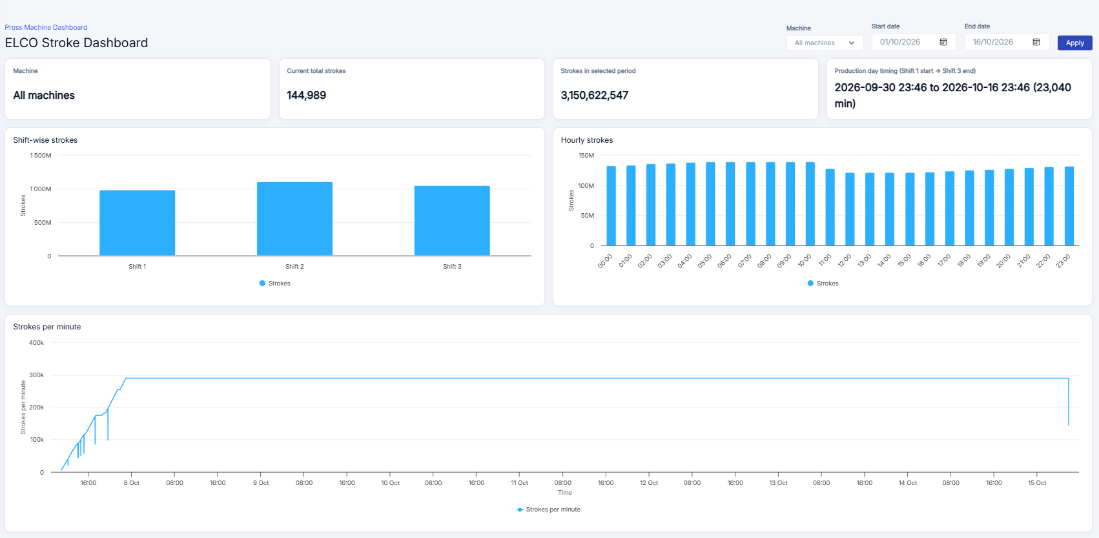
Completed Tasks
Elco Device Data Collection :
LGB l Operations Technology

Slide 10
04
Pongalur Plant

Slide 11
Pongalur ( OCT PLAN vs ACTUAL )
Pongalur
S.No | Task Description | Responsibility | Planned |  | Actual |  | Status | % Complete | Remarks
 |  |  | Start Date | End Date | Start Date | End Date
1 | CNC & VMC Data Collection | Plant Electrical | 15-Sep-26 | 15-Oct-26 | 01-Oct-26 | 30-Oct-26 | InProgress | 10% | Waiting for IOT device(Texonics device demo on Tuesday)
2 | Operator Buddy Implementation | Plant IT | 20-Sep-26 | 01-Oct-26 | 18-Oct-26 | 07-Nov-26 | InProgress | 10% | Data Collection & Device Purchase is Pending
3 | SQF Data Collection (Charge In and Charge Out) | Plant Electrical | 01-Aug-26 | 30-Sep-26 | 15-Sep-26 | 31-Oct-26 | InProgress | 20% | Wiring is Pending(Remainder mail has been given )
4 | Energy Meter Data Collection | Plant Electrical | 01-Aug-26 | 15-Sep-26 | 01-Oct-26 | 31-Oct-26 | InProgress | 10% | Order has been placed device need to arrive
5 | OB drawing view feedback | Plant Team | 28-Sep-26 | 01-OCT-26 | 05-OCT-26 | 31-OCT-26 | InProgress | 50% | Plant Team give the Feedback on month end
LGB l Operations Technology

Slide 12
05
P.Palayam Plant

Slide 13
P.Palayam ( OCT PLAN vs ACTUAL )
P.Palayam
S.No | Line | Task Description | Responsibility | Planned |  | Actual |  | Status | % Complete | Remarks
 |  |  |  | Start Date | End Date | Start Date | End Date
1 | SQF | Furnace Data Collection | Plant IT | 15-Sep-26 | 15-Oct-26 | 01-Oct-26 | 16-Oct-26 | Completed | 100% | -
2 | Chain | Press Data Collection | Noufal | 20-Sep-26 | 01-Oct-26 | 01-Oct-26 | 17-Nov-26 | InProgress | 10% | R&D is pending
3 | Daimler | Machine Data Collection | Plant IT | 22-Sep-26 | 22-Oct-26 | 30-Sep-26 | 31-Oct-26 | InProgress | 5% | Ethernet is Pending
4 | Daimler | Data Collection from Cobot PLC | Plant IT | 27-Sep-26 | 27-Oct-26 | 01-Oct-26 | 31-Oct-26 | InProgress | 40% | Ethernet and Switch Installation is Pending
5 | Stellantis | Dashboard Stellantis line | Robonetics Vendor | 01-Sep-26 | 30-Sep-26 | 01-Oct-26 | 17-Oct-26 | Completed | 100% | -
6 | Stellantis | OP20 Machine Data Collection | Plant Production | 30-Sep-26 | 30-Oct-26 | 01-Oct-26 | 30-Oct-26 | InProgress | 10% | Device Purchase is Pending
LGB l Operations Technology

Slide 14
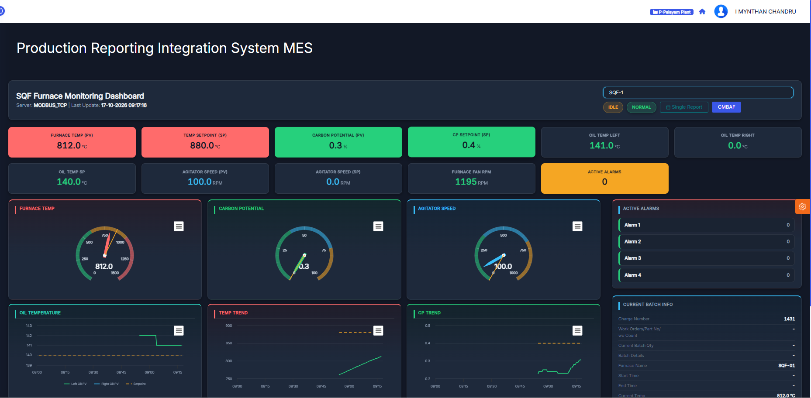
Completed Tasks
SQF furnace 1&2
LGB l Operations Technology

Slide 15
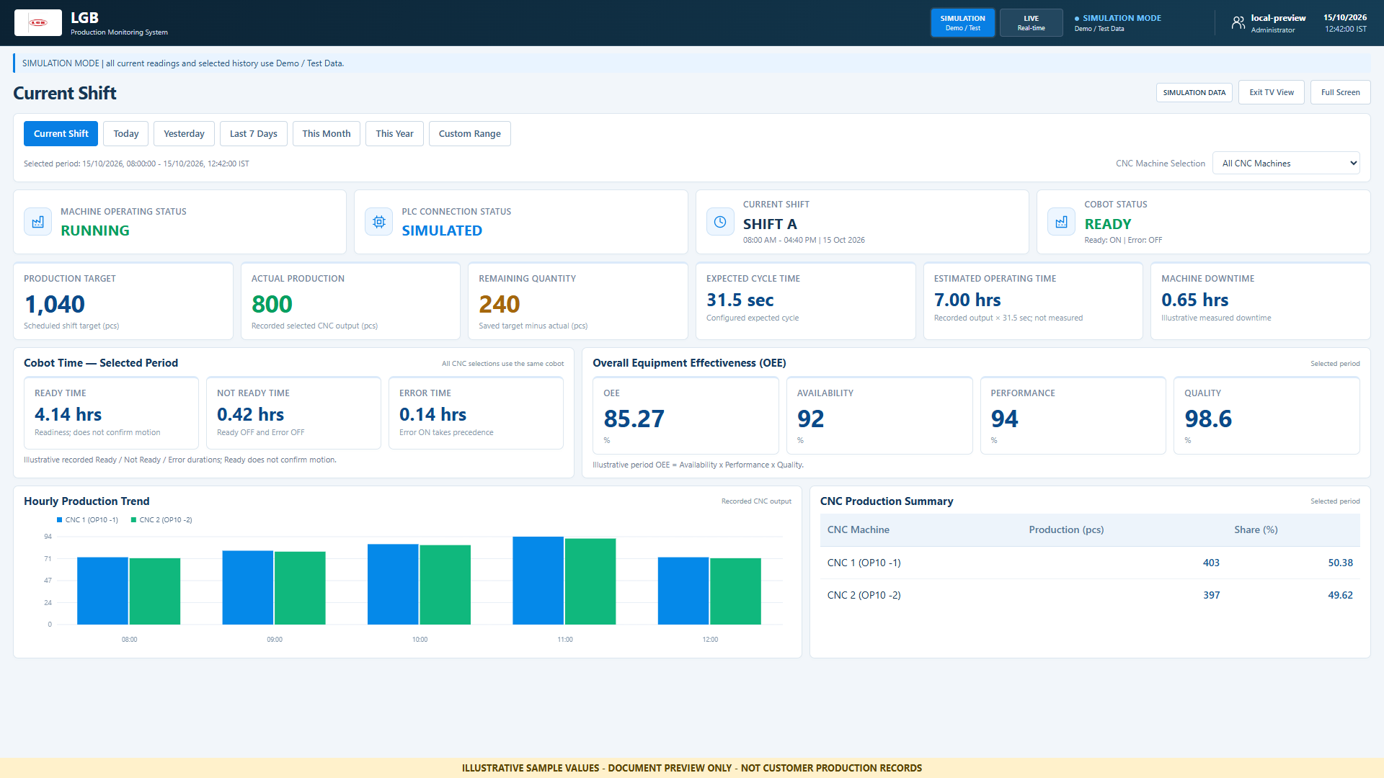
Completed Tasks
Dashboard Stellantis shopfloor
:
LGB l Operations Technology

Slide 16
06
Vaiyampalayam Plant

Slide 17
Vaiyampalayam ( OCT PLAN vs ACTUAL )
Vaiyampalayam
S.No | Line | Task Description | Responsibility | Planned |  | Actual |  | Status | % Complete | Remarks
 |  |  |  | Start Date | End Date | Start Date | End Date
1 | SQF | Furnace Data Collection | Gowtham | 15-Aug-26 | 15-Sep-26 | 28-Oct-26 | 30-Oct-26 | InProgress | 50% | 1&2 Modbus Protocol not available, need support from MBD
LGB l Operations Technology

Slide 18
07
Nagpur Plant

Slide 19
Nagpur ( OCT PLAN vs ACTUAL )
Nagpur
S.No | Task Description | Responsibility | Planned |  | Actual |  | Status | % Complete | Remarks
 |  |  | Start Date | End Date | Start Date | End Date
1 | CNC Data Collection | Plant IT | 01-Oct-26 | 15-Sep-26 | 13-Nov-26 | 30-Dec-26 | Not Started | 10% | Server PC Purchase is Pending
LGB l Operations Technology

Slide 20
08
New Projects

Slide 21
New Project list ( OCT PLAN vs ACTUAL )
Nagpur
S.No | Task Description | Responsibility | Planned |  | Actual |  | Status | % Complete | Remarks
 |  |  | Start Date | End Date | Start Date | End Date
1 | ST588 Tensioner Qr code data capturing | Mynthan | 10-Oct-26 | 15-OCT-26 | 14-Nov-26 | 20-Nov-26 | Not Started | 10% | Need to prepare SRS document
2 | CCTV-Based Cobot Safety System | Mynthan & Dinesh | 01-DEC-26 | 01-Jan-27 | - | - | Not Started
3 | Voice-Controlled PLC Cobot Using Python | Mynthan & Dinesh | 01-Nov-26 | 01-Dec-26 | - | - | Not Started
LGB l Operations Technology

Slide 22
October 2026
Project progress review
LGB | Operations Technology
Thank You

